Slide 1
Zeta Psi Mentorship Program Walking Deck. May 22, 2023 v8
“Show me a successful individual and I’ll show you someone who had real positive influences in his or her life. I don’t care what you do for a living—if you do it well, I’m sure there was someone cheering you on or showing the way. A mentor.” — Denzel Washington

Slide 2
Topics.
VISION & GOALS
FRAMEWORK & APPROACH
Roles & responsibilities
ROADMAP
Next steps & call to action
APPENDIX

Slide 3
Vision & Goals

Slide 4
The vision.
Develop Zeta Psi Mentorship Program that accelerates the personal and professional development of Phi Lambda undergraduates. This is achieved by providing mentees with guidance, advice and feedback from mentors with more experience than themselves.

Slide 5
Program goals.
Support Zeta Psi undergraduates with coaching, information, contacts, and guidance to enhance their educational path at UW and position them for career opportunities
Change the narrative on our fraternity from 'we don't haze’ to 'we focus on helping you transition from college to career’
Drive alumni connection and engagement
Strengthen recruitment thru a differentiated program offering a competitive advantage
Provide recruiting pool for Zeta Psi Alumni workforce

Slide 6
Framework & Approach

Slide 7
Framework and approach.
Mentoring activities and events will evolve as undergrads approach graduation
Early years will be focused on awareness, knowledge transfer and information sharing. Later years will be focused on one-on-one mentoring & coaching and readiness for landing a job.
MENTORSHIP PROGRAM
Programmatic
Partnership
Bias for Action
Test & Learn
Anchor events will happen twice a year, with more focused mentoring and digital offerings in between. Summer quarter out of scope.
Mentoring is a two-way street that requires accountability on both sides. Impact is accrued when both parties get value out of this effort.
There aren’t a lot of these programs floating around college campuses today to draw from, and nothing from nationals to leverage. We are just going to start.
It won’t be perfect out of the gate, but we’ll action on your feedback and look to iterate. We are casting a wide net and taking an inclusive approach.
FRAMEWORK
APPROACH
ALUMNI & UNDERGRAD PROGRAM OWNERS
CONSISTENT & PREDICTABLE
PROGRAM GOVERNANCE
CONTINUOUS IMPROVEMENT

Slide 8
Mentoring Focus & Alumni Opportunities - by year.
Audience | Pre-UW | Freshman | Sophomore | Junior | Senior | Post Grad
Mentorship Focus: | Awareness and education Strong value proposition for recruitment | Knowledge transfer & Information sharing | Generic group mentoring and coaching Mentoring to help align majors/degrees to careers | Building skills for landing internship Securing internships | Recommendations / Referrals to companies of interest Connections to young alumni in like industries/roles | Networking
Alumni Role Opportunities: | Social Marketing Lead | Mentorship Alumni Member | Mentorship Alumni Member Mentor Alumni Speakers | Mentorship Alumni Member Company POC Mentor Alumni Speakers | Mentorship Alumni Member Company POC Mentor Alumni Speakers | Young Alumni Ambassadors & Members

Slide 9
Roles & Responsibilities

Slide 10
Roles & Responsibilities.
Role | Responsibilities | Level of Effort (LOE)
Core Team | Get the program stood up | Sunset post launch
Executive Sponsor (Alumni & UG Board) | Escalations, clearly ongoing roadblocks, budget approval | 1 hour per quarter
Undergraduate Program Lead | Ongoing execution, activities and events schedule, mentor management; develops social marketing requirements and hands-off to Zeta Psi Social Marketing Lead* | 5-7 hours per month with increased commitment around anchor events
Alumni Program Lead | Ongoing execution, activities and events schedule, mentoree management | 5 hours per month
Mentorship Program Alumni Member | Participate in and support membership program in line with interest and capacity | Variable
Mentor | 1:few and 1:1planning and execution, ongoing connections | 2 hours per month
Mentoree | Meeting prep, meeting attendance, ongoing connections | 1 hours per month
Company POC | Local contact willing to provide recruiting help to undergraduates | 2 hour per month
Young Alumni Lead | Facilitates Young Alumni events | 2 hours per month
Alumni Speakers | Available for digital broadcasts | 2 hours per quarter

Slide 11
Roadmap

Slide 12
Roadmap.
Recurring Events.
SPRING QUARTER
Recruitment Support
FALL QUARTER
Anchor Event
Career Day
SUMMER QUARTER Young Alumni Event & Program Planning
WINTER QUARTER
Anchor Event
Resume / Interview / Networking Workshop
Always-on Programing (Fall – Spring).
MENTORING (one:one, one:many, mentoring roundtables)
DIGITA EVENTS (LinkedIn Live, community calls, knowledge and skill building)
Notes:
Mentoring
1:1 Mentoring
1:Many Mentoring
Mentoring roundtables
Digital Events
LinkedIn Live by major, topic, or role
Community calls
Knowledge and skills building
Workshops
Career Days
Resume & cover letter writing
Interviewing prep

Slide 13
Next Steps & Call to Action 1) Sign up for Phi Lambda LinkedIn Group: Zeta Psi - Phi Lambda (UW) | Groups | LinkedIn 2) Email B.J. @ bjmcmahon@consultcascade.com and confirm your interest in joining the ZY Mentorship Program and highlight the role(s) you would like to participate in. 3) Stay tuned for future Mentorship Program events and activities.

Slide 14
Appendix – Mentoring Approach Details - by Year

Slide 15
1. [Pre-UW]
Target by school year.
FOCUS
Awareness and education
Strong value proposition for recruitment
NEEDS/INTERESTS
Mentorship as a differentiator for recruitment
Rebrand Zeta Psi as a student body organization for life, with emphasis on supporting undergrads from college to work life
Accelerating transition and setting young men up for success
Target audience is incoming freshman, and Moms & Dads
EVENTS
Digital content on Zeta Psi website, Facebook and Instagram
Social outreach positioning Zeta Psi Mentorship Program as a competitive advantage

Slide 16
2. [Freshman]
Target by school year.
FOCUS
Knowledge transfer & Information sharing
NEEDS/INTERESTS
Discovery – help identifying majors, degrees, companies & roles
Initial contact with alumni in fields of interest
EVENTS
Anchor events
Relationship building events thru social and digital
Career Days
Alumni speaker panels

Slide 17
3. [Sophomore]
Target by school year.
FOCUS
Generic group mentoring and coaching
Mentoring to help align majors/degrees to careers
NEEDS/INTERESTS
Career path by major/degree
Exposure to how degrees translate to careers
EVENTS
Anchor events
Relationship building events thru social and digital
Career Days
Alumni speaker panels
Generic group mentoring and coaching
Group mentoring to help align majors/degrees to careers

Slide 18
4. [Junior]
Target by school year.
FOCUS
Building skills for landing internship
Securing internships
NEEDS/INTERESTS
Industry knowledge
Career advise
Resume writing and interview prep/skills
EVENTS
Anchor events
Relationship building events thru social and digital
Career Days
Group mentoring workshops (review interview techniques, cover letters, resumes, mock interviews)
1:1 mentoring

Slide 19
5. [Senior]
Target by school year.
FOCUS
Recommendations/ Referrals to companies of interest
Connections to young alumni in like industries/roles
NEEDS/INTERESTS
Job shadowing
Applying for jobs
Interviewing skills
ZY networking and contacts
Focused mentoring
EVENTS
1:1 mentoring
‘Young Alumni’ events
Networking & contact generation via digital platform (LinkedIn, etc.)
Interview prep workshop

Slide 20
6. [Post Grad (+5 Yrs.)]
Target by school year.
FOCUS
Networking
NEEDS/INTERESTS
Maintaining connection to Zeta Psi
Ability to give back without opening wallet
Early career learnings amongst ‘Young Alumni’
Early career job opportunities amongst ‘Young Alumni’
Mentorship opportunities
EVENTS
‘Young Alumni’ events (social & early career learnings/opportunities)
Group and 1:1 mentoring sessions

Slide 21
Core Team

Slide 22
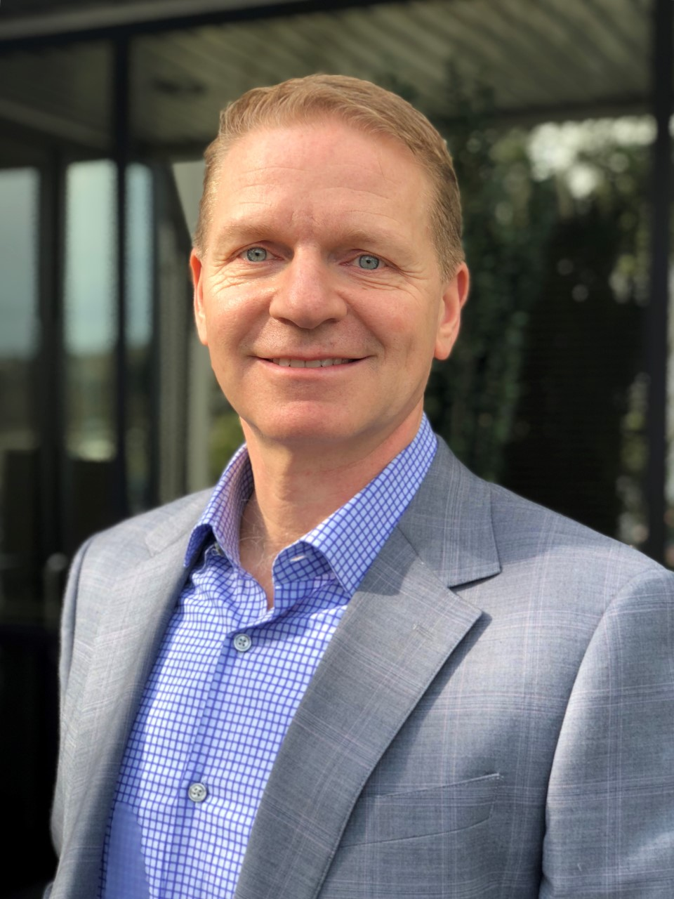
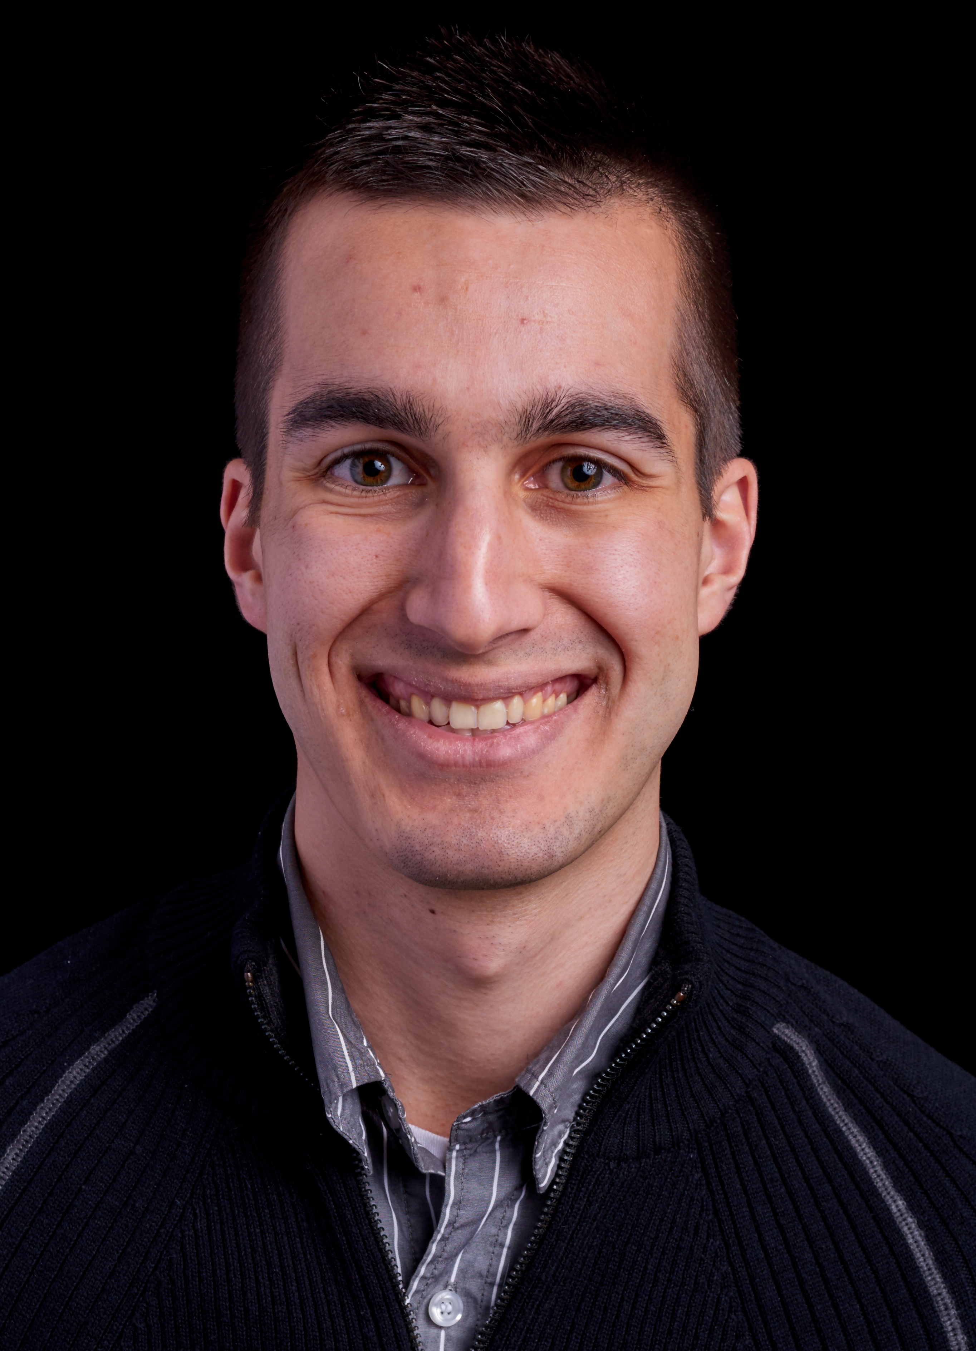
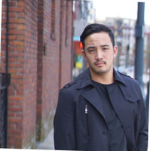
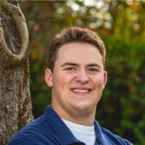
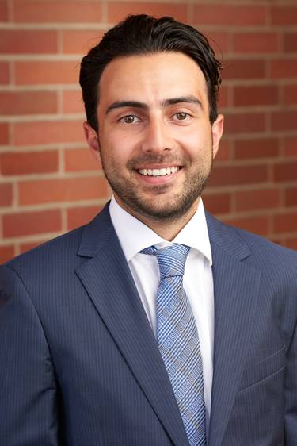
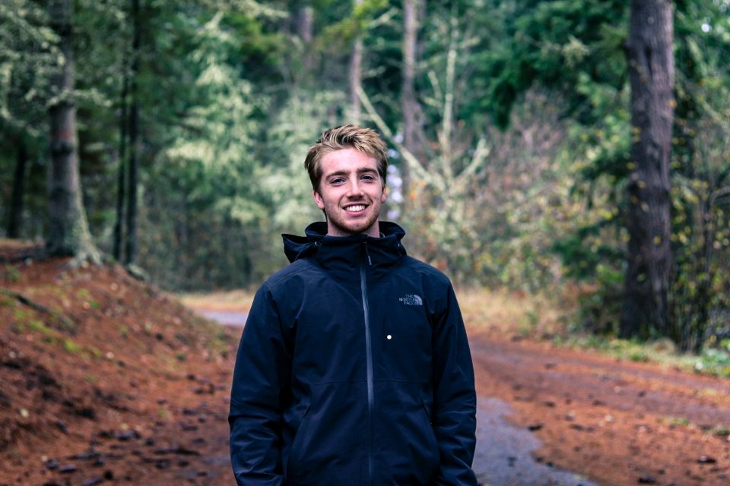
Meet your core team.
Click icon to add picture
Click icon to add picture
Click icon to add picture
Click icon to add picture
BJ McMahon
Business Administration
PC 85
Brad Miller
Business Administration
PC 85
AUSTIN TUCKER
Business Administration
PC 12
JERRY WANG
Construction Management
PC 08
Click icon to add picture
Click icon to add picture
Click icon to add picture
Click icon to add picture
Ryan THOMSON
Mechanical Engineering
PC 20
ROHAN KUMAR
Business / Finance
PC 16
CALVIN JENSEN
Finance & Info Systems
PC 19
RYAN CARROLL
Informatics
PC 19

Slide 23
Continuous improvement.
FLYWHEEL AFFECT
Identify Needs
Kaizen defined. Concept of creating small, positive changes top eventually reap major improvements.
Creates a ‘flywheel effect’ thru deep collaboration and communication between Alumni and undergraduates
Standardize & Adopt
Create Solution
Continuous Improvement cycle
Analyze Results
Test Solution

Slide 24
Governance

Slide 25
Governance model.
Executive Sponsor
Alumni & UG Leadership Board
Standing agenda item at monthly board meeting to clear roadblocks, approve funding, provide guidance and support.
Alumni and undergrad leads are appointed annually and are accountable for program execution. They are primary point of contact for the day-to-day operations and execution of activities and events.
Program Ownership
Alumni Program Lead
Undergrad Program Lead
Company POCs
Social Marketing Manager
Young Alumni Lead
Alumni Speakers
Mentor
Mentoree
Company 1
Alumni Speakers
Mentor
Mentoree
Company 2
Alumni Speakers
Mentor
Mentoree
Company N
Alumni Speakers

Slide 26
Roster

Slide 27
Roles & Responsibilities.
Role | Responsibilities | Level of Effort (LOE) | Member
Core Team | Get the program stood up | Sunset post launch | Per Slide 22
Executive Sponsor (Alumni & UG Board) | Escalations, clearly ongoing roadblocks, budget approval | 1 hour per quarter | Alumni & UG Board
Undergraduate Program Lead | Ongoing execution, activities and events schedule, mentor management; develops social marketing requirements and hands-off to Zeta Psi Social Marketing Lead* | 5-7 hours per month with increased commitment around anchor events | Derek Schwarze
Alumni Program Lead | Ongoing execution, activities and events schedule, mentoree management | 5 hours per month | B.J. McMahon
Mentorship Program Alumni Member | Participate in and support membership program in line with interest and capacity | Variable | Several Alumni
Mentor | 1:few and 1:1planning and execution, ongoing connections | 2 hours per month | Several Alumni
Mentoree | Meeting prep, meeting attendance, ongoing connections | 1 hours per month | Several Undergraduates
Company POC | Local contact willing to provide recruiting help to undergraduates | 2 hour per month | Several Alumni
Young Alumni Lead | Facilitates Young Alumni events | 2 hours per month | Rohan Kumar
Alumni Speakers | Available for digital broadcasts | 2 hours per quarter | Several Alumni

Slide 28
Let’s Begin

